Slide 1

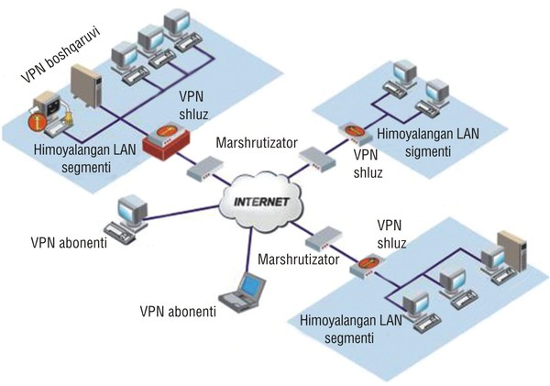
TARMOQ ADMINISTRATORLIGI 27-DARS

Slide 2

LINUX CentOS 7 PHPMYADMIN
yum -y install epel-release
yum -y install phpmyadmin
nano /etc/httpd/conf.d/phpMyAdmin.conf

Slide 3
LINUX CentOS 7 PHPMYADMIN
<Directory /usr/share/phpMyAdmin/>
AddDefaultCharset UTF-8
<IfModule mod_authz_core.c>
# Apache 2.4
<RequireAny>
#Require ip 127.0.0.1
#Require ip ::1
Require all granted
</RequireAny>
</IfModule>
<IfModule !mod_authz_core.c>
# Apache 2.2
Order Deny,Allow
Deny from All
Allow from 127.0.0.1
Allow from ::1
</IfModule>
</Directory>
<Directory /usr/share/phpMyAdmin/setup/>
<IfModule mod_authz_core.c>
# Apache 2.4
<RequireAny>
#Require ip 127.0.0.1
#Require ip ::1
Require all granted
</RequireAny>
</IfModule>
<IfModule !mod_authz_core.c>
# Apache 2.2
Order Deny,Allow
Deny from All
Allow from 127.0.0.1
Allow from ::1
</IfModule>
</Directory>

Slide 4
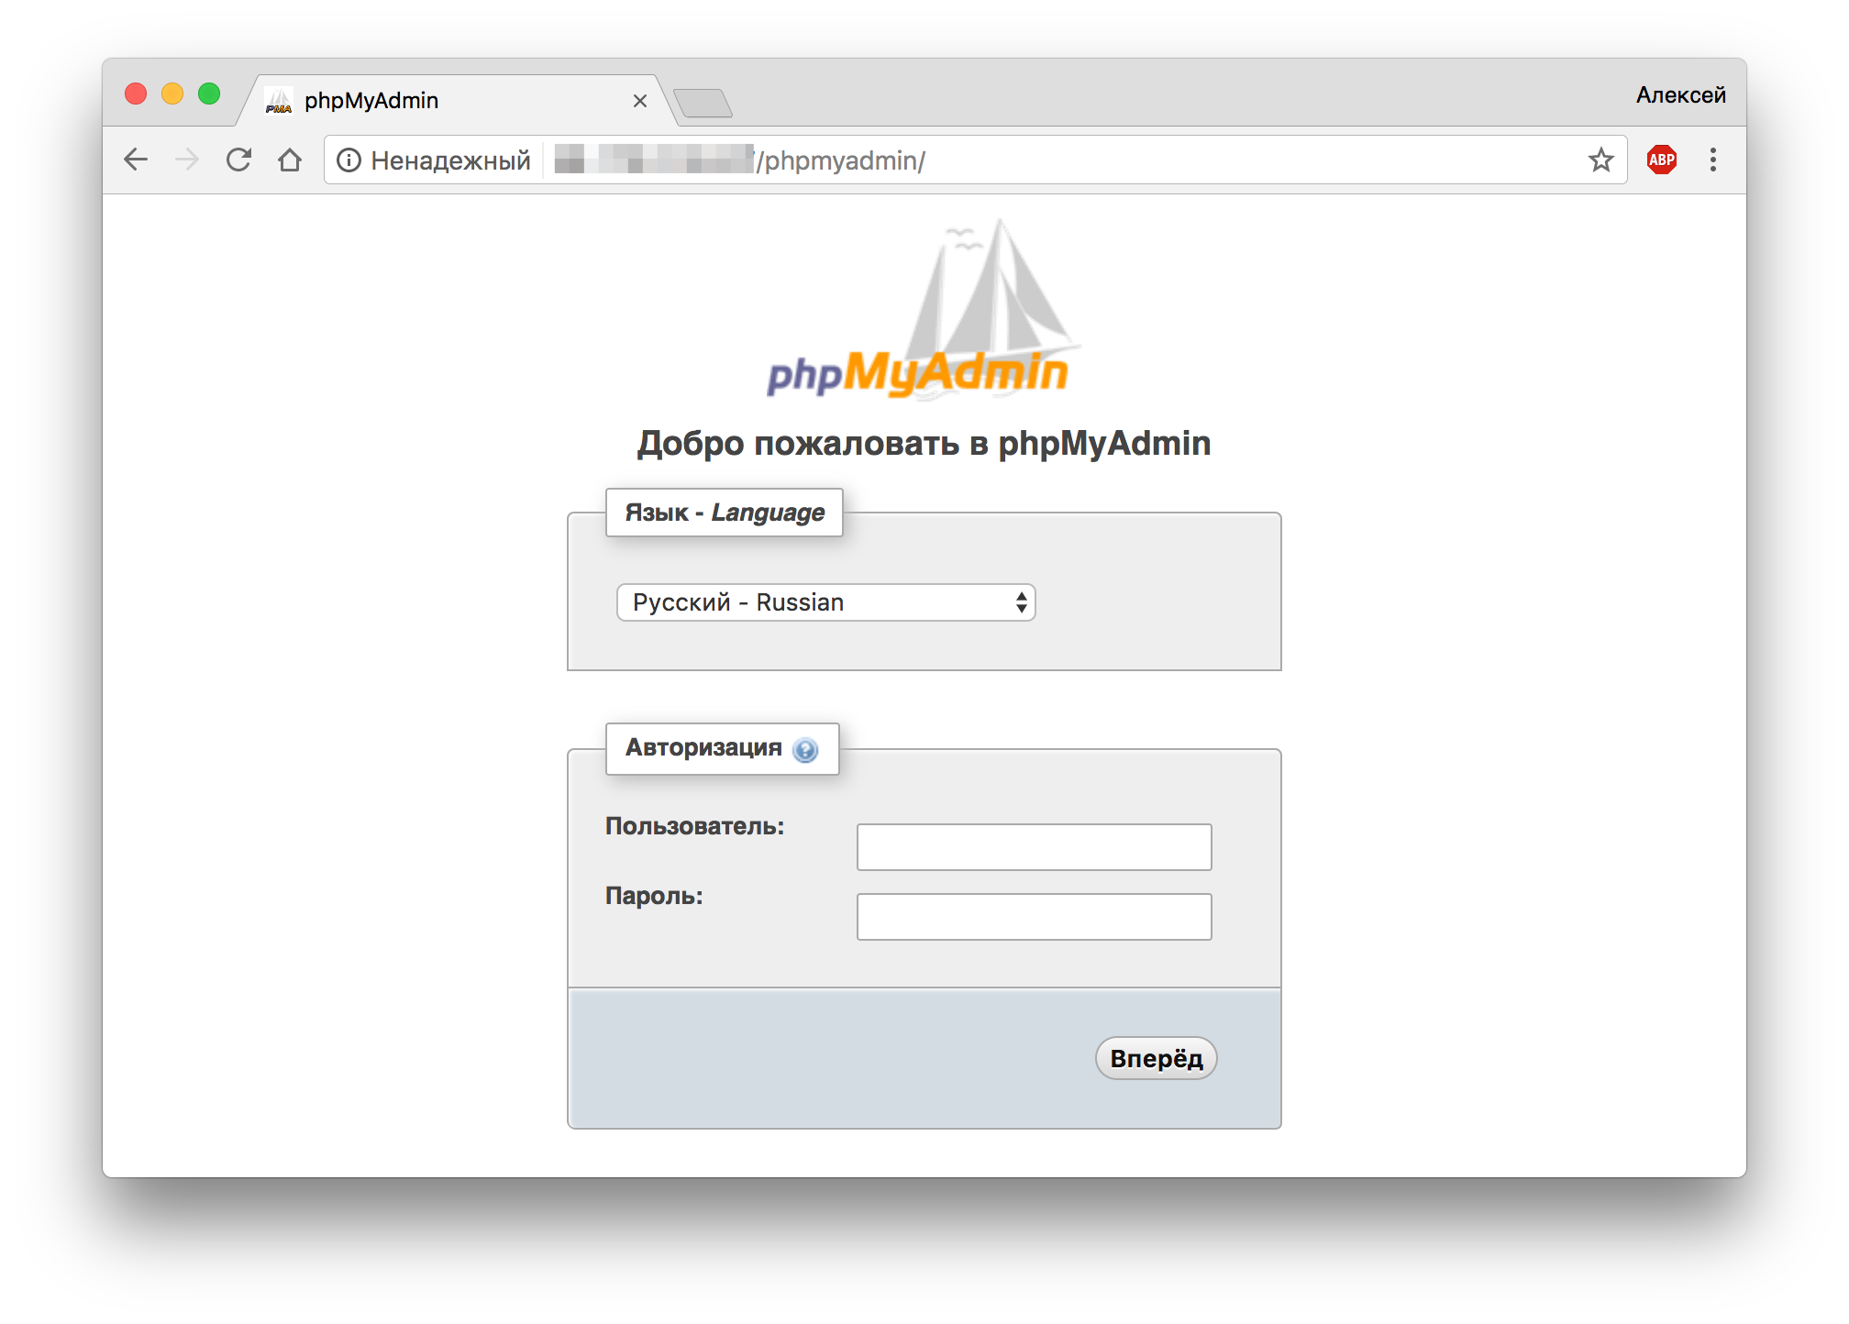
LINUX CentOS 7 PHPMYADMIN
systemctl restart httpd
http://IP_SERVER/phpmyadmin/

Slide 5
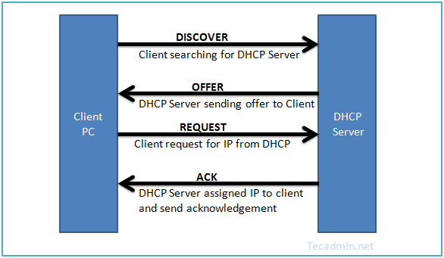
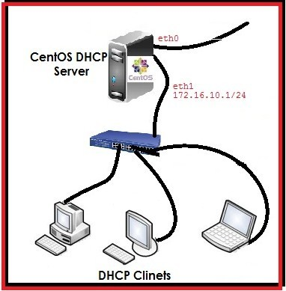

LINUX CentOS 7 DHCP SERVER

Slide 6
LINUX CentOS 7 DHCP SERVER
yum -y install dhcp
nano /etc/sysconfig/dhcpd
DHCPDARGS=eth0
cp /usr/share/doc/dhcp-4.2.5/dhcpd.conf.example /etc/dhcp/dhcpd.conf
nano /etc/dhcp/dhcpd.conf

Slide 7
LINUX CentOS 7 DHCP SERVER
option domain-name “telecom.org";
option domain-name-servers ns1.telecom.org;
default-lease-time 3600;
max-lease-time 7200;
authoritative;

Slide 8
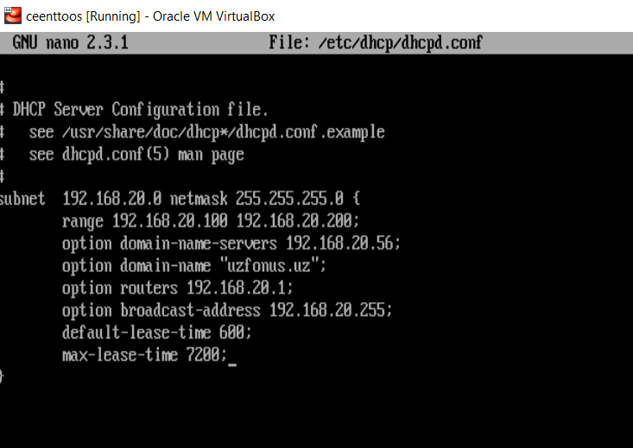
DHCP sozlash

Slide 9
LINUX CentOS 7 DHCP SERVER
subnet 192.168.56.0 netmask 255.255.255.0 {
option routers 192.168.56.1;
option subnet-mask 255.255.255.0;
option domain-search “telecom.org";
option domain-name-servers 192.168.56.1;
range 192.168.56.10 192.168.56.100;
range 192.168.56.120 192.168.56.200;
}

Slide 10
LINUX CentOS 7 DHCP SERVER
host ubuntu-node {
hardware ethernet 00:f0:m4:6y:89:0g;
fixed-address 192.168.56.105;
}
host fedora-node {
hardware ethernet 00:4g:8h:13:8h:3a;
fixed-address 192.168.56.110;
}

Slide 11
LINUX CentOS 7 DHCP SERVER
---------- On CentOS/RHEL 7 ----------
# systemctl start dhcpd
# systemctl enable dhcpd
# firewall-cmd --add-service=dhcp --permanent
# firewall-cmd --reload

